Slide 1
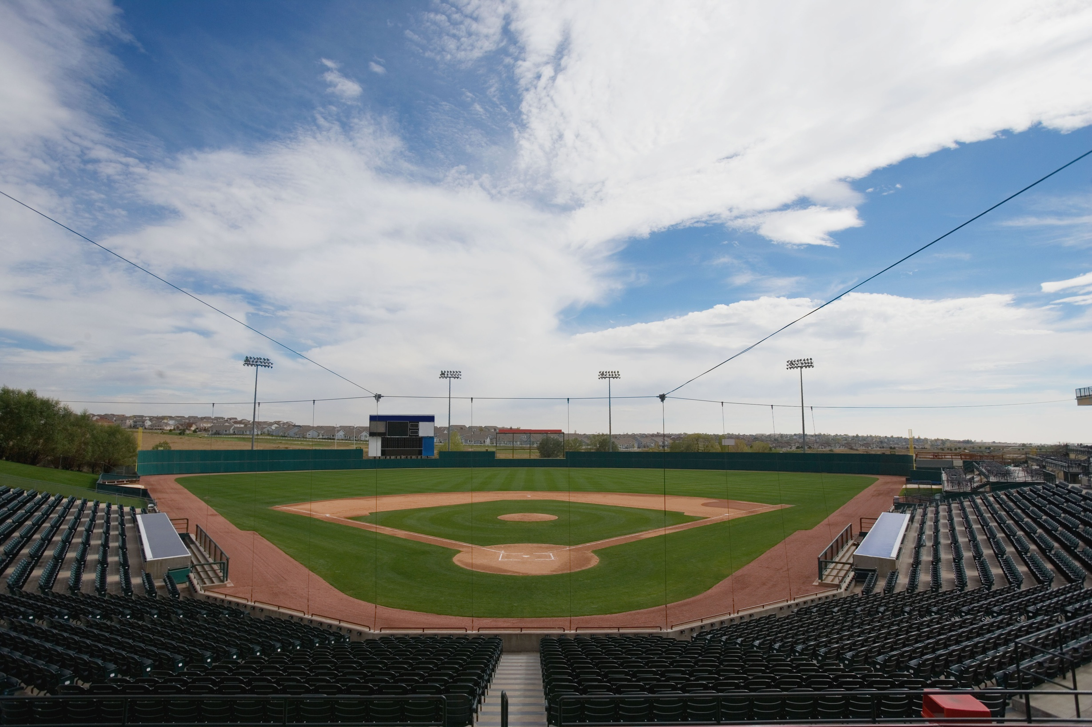

WEB
PROGRAMMING CLUB
PROJECT
“ A BETTER WEBSITE FOR GACHON WIND BASEBALL CLUB “
Web Development Team 16:
  Ooi Yong Wee (202699472)
  Jasper Teo Kheng Cher (202699473)
  Wong Deng Foong (202699475)
  Wong Guan Qi Ryan (202699476)

Slide 2
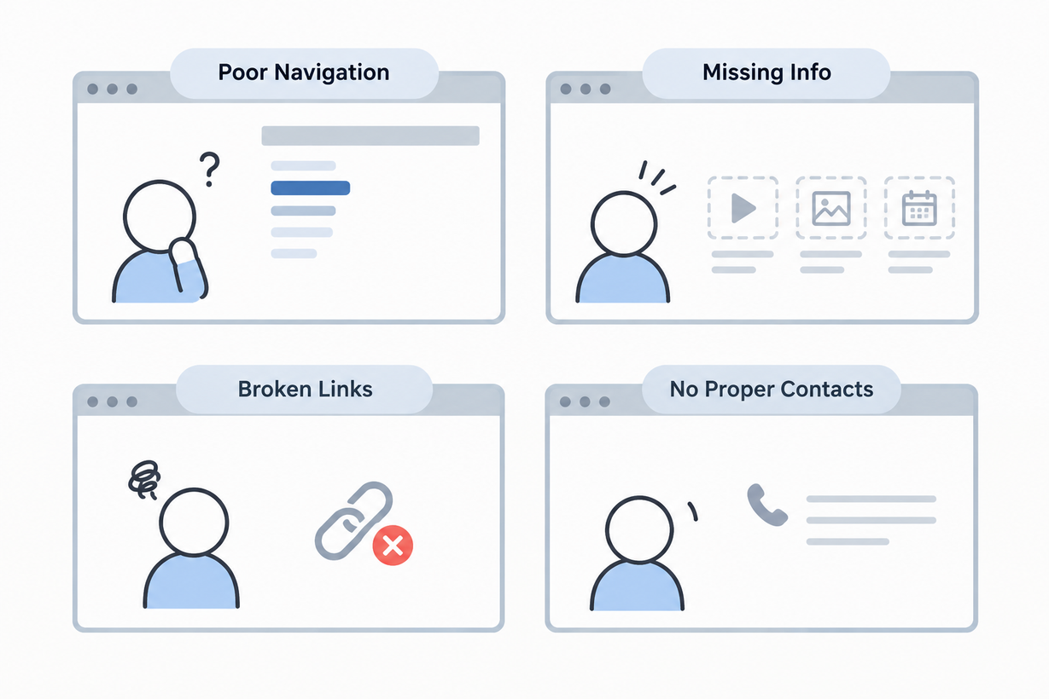
FOUR DEAD ENDS
  POOR NAVIGATION: UNCLEAR INSTRUCTIONS MAKE GACHON WIND DIFFICULT TO FIND AND JOIN, ESPECIALLY FOR INTERNATIONAL STUDENTS.
  MISSING INFO: LACK OF VIDEOS, PHOTOS, AND PRACTICE TIMETABLES MAKES IT DIFFICULT TO UNDERSTAND CCA ACTIVITIES AND SCHEDULES.
  BROKEN LINKS: THE CLUB'S HOMEPAGE LINK ON GACHON'S CCA PAGE IS NOT WORKING, MAKING IT DIFFICULT TO ACCESS CLUB INFORMATION.
  NO PROPER CONTACTS: LACK OF CLEAR CONTACT DETAILS DISCOURAGES INTERESTED STUDENTS FROM JOINING THE CLUB.

Slide 3


TWO SOURCES, NEITHER COMPLETE
GACHON CCA PAGE: OFFICIAL CLUB LISTING, BUT THE HOMEPAGE LINK IS BROKEN. LINK
INSTAGRAM (@GCU_WIND): REAL TEAM PHOTOS, BUT LIMITED UPDATES. LINK
KEY INFORMATION NO PRACTICE SCHEDULE, SIGN-UP FORM, OR CLEAR CONTACT DETAILS.
WHAT EXISTS?

Slide 4
OUR SOLUTIONS
DISCOVER
JOIN
LANGUAGE TRANSLATION
Club info, photos, videos and the game schedule in one place that always works
An online sign-up form and clear contacts replace broken links and dead ends
In English, Korean, Vietnamese and Japanese for Gachon's international students

Slide 5

KEY FEATURES
ALL IN ONE SITE
1.CLUB PROFILE, ACTIVITIES AND UPCOMING EVENTS
2. A SCHEDULE OF EVERY FUTURE BASEBALL GAME
3.SIGN-UP FORM, JOINING STEPS AND CONTACT DETAILS
4.PHOTO AND VIDEO GALLERY, MOBILE-FRIENDLY AND INTERACTIVE, WITH A LANGUAGE SWITCH

Slide 6
WHY IT'S BETTER
ALWAYS CURRENT
EASY TO JOIN
TRULY ACCESSIBLE
The CCA page is static and Instagram rarely posts; our schedule and gallery stay up to date
Neither existing option has a sign-up form or working contact; ours takes a few clicks
Four languages and a mobile-first layout, so every Gachon student can use it

Slide 7
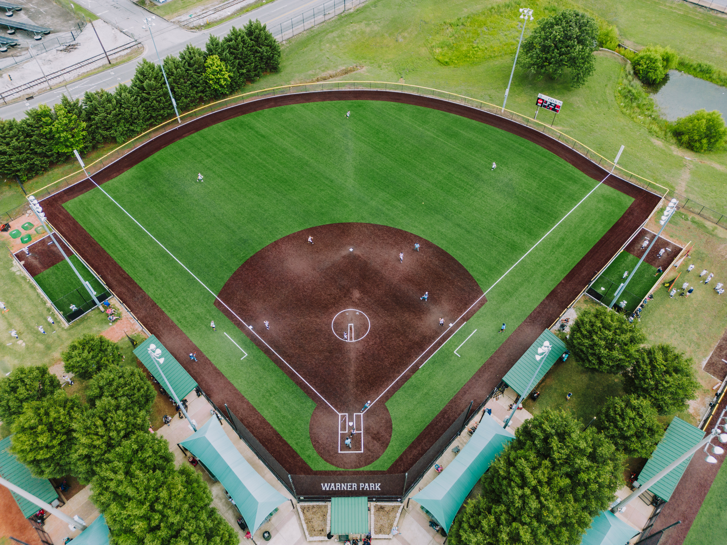
FOUR PHASE PLAN
1. PLAN & DESIGN: COLLECT CLUB CONTENT, SITE MAP AND WIREFRAMES
3. TEST & FEEDBACK: PHONES, BROWSERS, WIND MEMBERS AND STUDENTS
2. DEVELOP: HTML & CSS PAGES, THEN JAVASCRIPT FOR SCHEDULE, GALLERY, FORM AND LANGUAGES
4. LAUNCH: FIX ISSUES, PUBLISH, AND HAND IT TO THE CLUB TO KEEP UPDATED

Slide 8
RYAN – HOMEPAGE AND CLUB INFO
YONG WEE – SCHEDULE AND EVENTS
JASPER – SIGN-UP APPLICATION FORM
DENG FOONG – MULTILINGUAL SUPPORT
OUR TEAM
TEAM

Slide 9
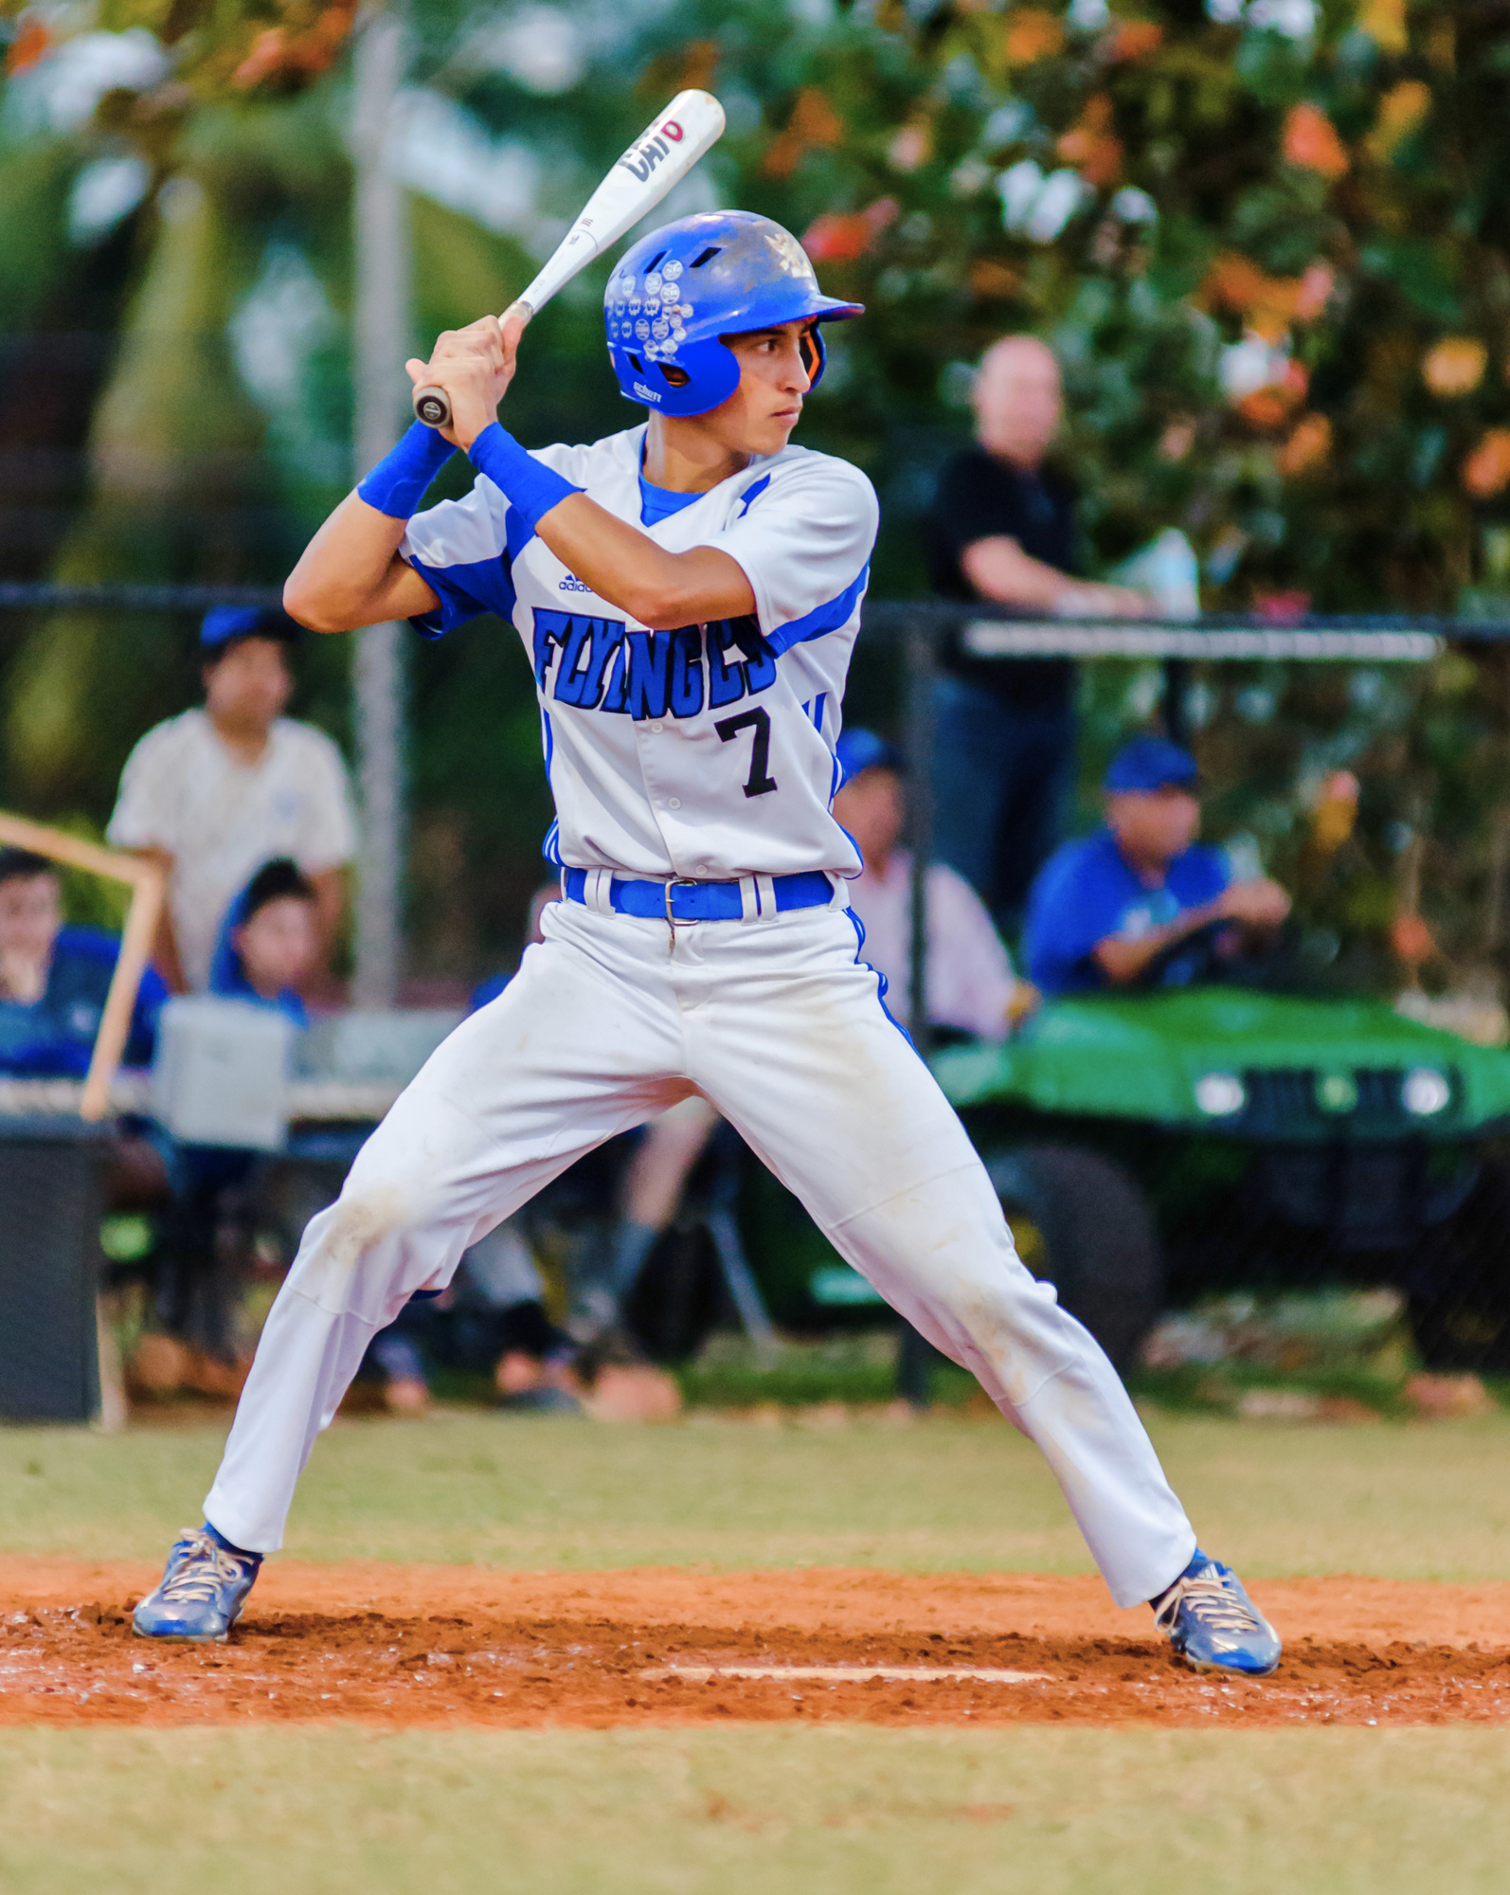
EASY TO JOIN
@GCU_WIND
OUR WEBSITE TURNS SCATTERED, OUTDATED INFO INTO ONE RELIABLE HOME FOR GACHON WIND
RESPONSIVE FOR DIFFERENT PLATFORMS
TEAM 16 · WEB PROGRAMMING
THANK YOU! QUESTIONS?
SIMPLE FOR THE CLUB TO KEEP UP TO DATE
MORE STUDENTS DISCOVER THE CLUB, SEE WHAT IT DOES AND SIGN UP, IN THEIR OWN LANGUAGE

